Slide 1
PROJECT-1
Ajay Kumar Gadireddy
Aravind Raj
Shatha Arvind
Zabiulla

Slide 2
PROBLEM STATEMENT
The basic idea of problem is we have to shift the position of 1 an array as according to the instructions given by the user such as UP,DOWN,LEFT,RIGHT.
The initial snap of the input may look like as follows:
Depending on the instructions we have to shift the 1s position and whenever a shift is not possible, we should leave the state of array unchanged.
Once the user enters “-1” the program should terminate.

Slide 3
APPROACH
The main logic behind the problem is to convert index of single dimension array to two-D array to verify whether it is a valid index.
For simplicity, we made columns as fixed size of 5 and the rows vary as according to length of One-D array.
Initially we will first find the index of 1 in One-D Array, say index.
From this, row and column can be calculated as
r = index / 5, c = index % 5 which are the positions of 1 if it is a 2-D array.
We will verify, if its a valid case as according to conditions:
Up=(r-1,c)
Down=(r+1,c)
Left=(r,c-1)
right=(r,c+1)

Slide 4
APPROACH
Once Verified, we convert back the 2-D index to 1-D index by using,
new index= R * 5 + C
where R=row transformed as according to direction given by user,
C=column transformed as according to direction given by user.
Shift the 1s position to new index.
Continue this Process until “-1” is entered by user.

Slide 5
ALGORITHM
The Algorithm for the problem is given below:
Step 1 : Take the length of input from user as well as array elements
Step 2 : Find the index of 1 in the array.
Step 3 : Take the input direction from user and continue ste4-step6 until “-1” is entered by user
Step 4 : Calculate r, c as r = index / 5, c = index % 5;
Step 5 : Verify whether it is valid index of suppoused 2-d array:
if Yes go to Step 6 else state remains unchanged.
Step 6 : Transform the 1s position as according to new index calculated as
newindex = R * 5 + C, R=transformed row
C=transformed column
Step 7 : Display the array to output Console.

Slide 6
Source code: https://github.com/ajaykumargadireddy/DotnetProjects.git

Slide 7
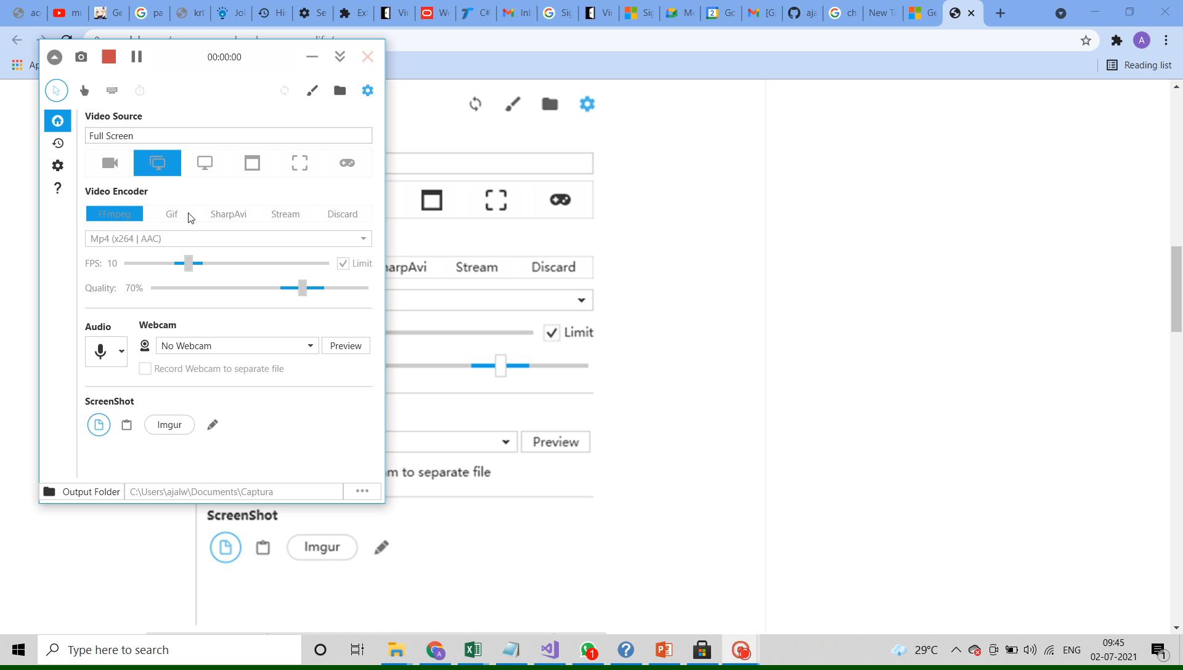
EXECUTION

Slide 8
Thank you

